Slide 1
Prototype 1 IoT4Lunch
Temperature Only

Slide 2
RaspberryPi
Teensy 1
Collect Temperature
Set Thresholds
Send Bluetooth to Raspberry Pi
Received Data from Teensy
*Set Threshold
import time
# Replace tempC with the actual temperature value you want to check
tempC = 6.5 # Example temperature value
if tempC < 4.0:
print(f"Temperature: {tempC}°C - [Safe]")
time.sleep(10) # Sleep for 10 seconds
elif 4.0 <= tempC <= 8.0:
print(f"Temperature: {tempC}°C - [Caution]")
time.sleep(10) # Sleep for 10 seconds
else:
print(f"Temperature: {tempC}°C - [Warning]")
time.sleep(10) # Sleep for 10 seconds

Slide 3
Teensy 2
Receive data from AWS
If msg.payload contains safe led 1 high
Else if msg.payload contains caution
led 2 high
Else msg.payload contains warning
led 3 high
buzzertone(1000)
delay 1 (Second)
buzztone off

Slide 4
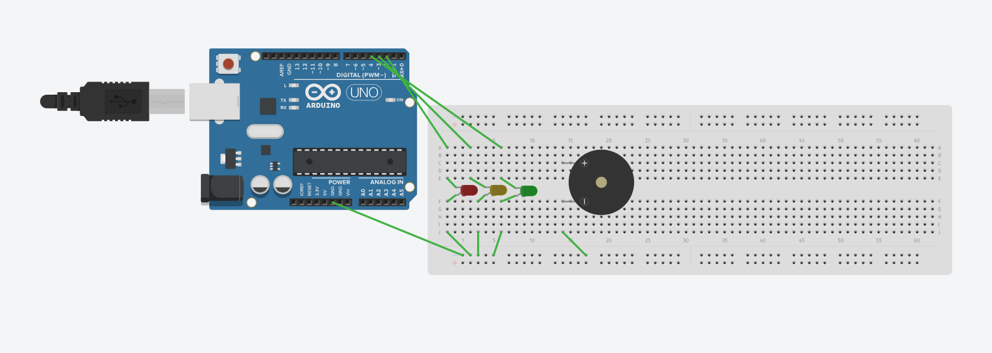
Actuator Led with Buzzer

Slide 5
Actuator Led with Buzzer
//Define Pins
const int led1 = 1; //Red LED
const int led2 = 2; //Yellow LED
const int led3 = 3; //Green LED
const int buzzer = 4; //Buzzer
void setup() {
Serial.begin(9600); // Delivering Data from Bluetooth
Serial1.begin(9600); // Incoming data from Bluetooth
pinMode(led1, OUTPUT);
pinMode(led2, OUTPUT);
pinMode(led3, OUTPUT);
pinMode(buzzer, OUTPUT);
}
void loop() {
// Check if there is incoming serial data
if (Serial1.available() > 0)
{
String str = Serial1.readString().substring(0); // Read the incoming data as a String
// Print received data for debugging
Serial.println("Received data: " + str);
// Check if the received data contains "warning" (case-insensitive)
if (str.indexOf("Warning") != -1)
{
// Turn on the LED
digitalWrite(led1, HIGH);
Serial.println("Warning");
tone(buzzer, 100);
delay(1000); // Keep the LED on for 1 second
noTone(buzzer);
digitalWrite(led1, LOW); // Turn off the LED
}
}
}

Slide 6
Receiving Notifications on Phone
What is AWS IoT Core?

Slide 7
8 Dot Matrix
https://electropeak.com/learn/using-8x8-dot-matrix-led-arduino-cascade-connection/

Slide 8
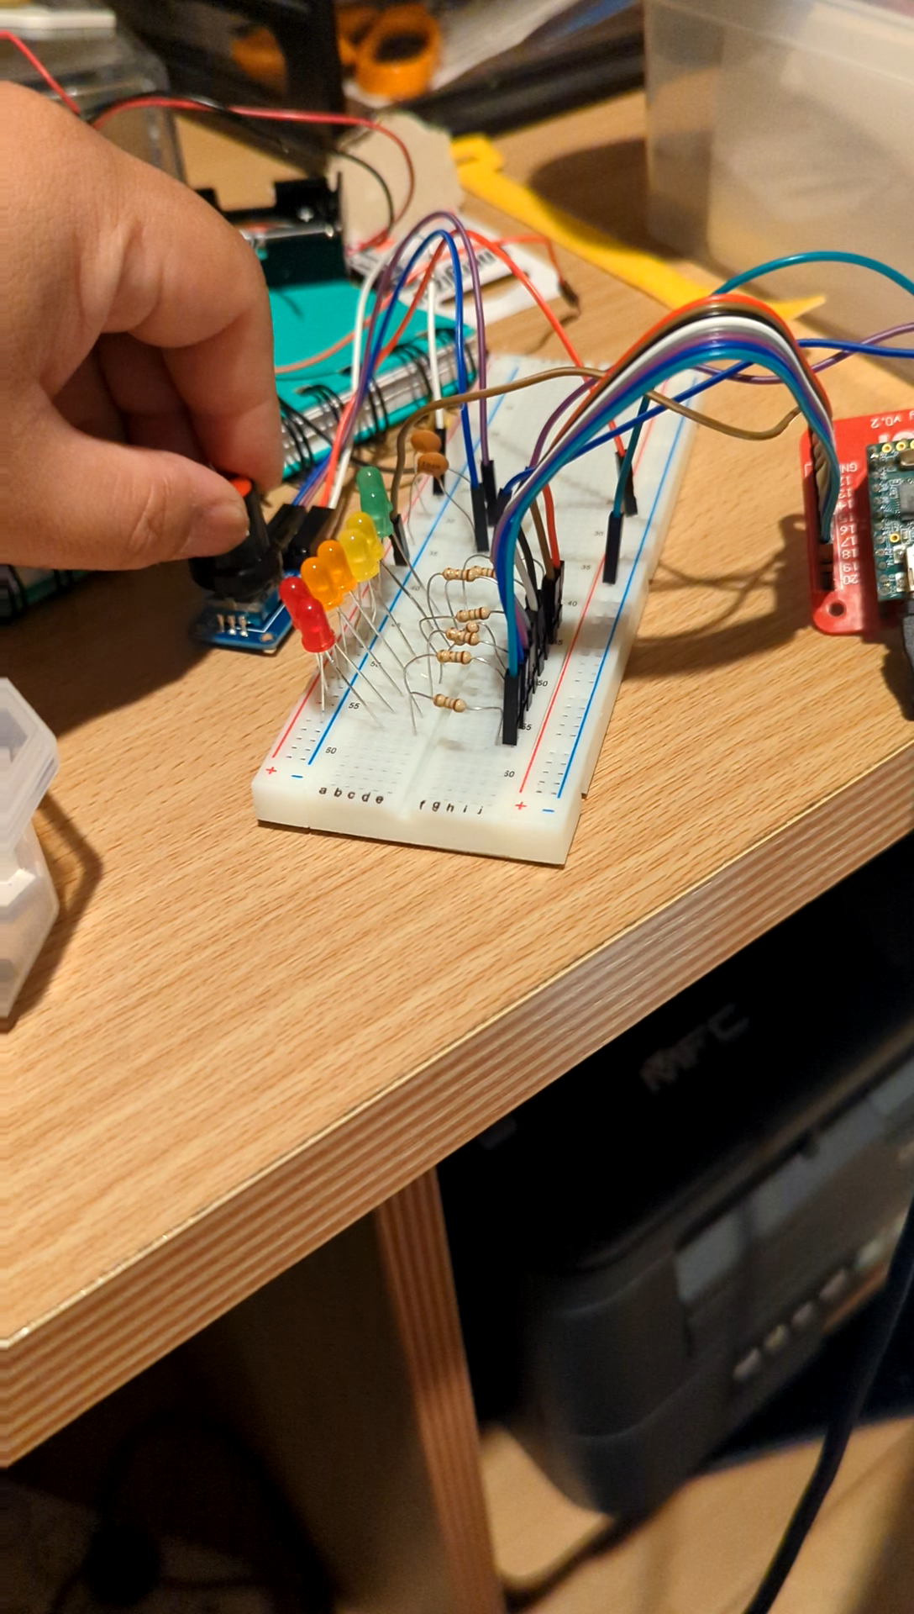
LED Rotary Encoder

Slide 9
Ideas
How to implement an led bar counter for IOT device.
Change polling rate.

Slide 10
Tri-sensor
X = 450 – 550 | Safe
Y = safe 600 , under 600 unsafe, 500 flat

Slide 11
Logic
IOT Device 1 : Temperature Sensor, XYZ Sensor, Bluetooth
Modes
Initialized – No Data
Mode 1 – Temperature And Motion
Mode 2 – Temperature
Mode 3 – Motion
Modes are set by IOT Device 2.
IOT Device 2 : 6 LEDs (4 in a Row, 2 Separate), Rotary Encoder, LED Button.
4 in a Row :
Red is Initialized
Green is – Temperature and Motion
Orange is Temperature
Yellow is Motion
2 Separate :
Green = In Mode
Red = Not in Current Mode
Rotary Encoder
Counter = 1-4. 1 is off, 2 is mode 1, 3 is mode 2, 4 is mode 3.
Switch = Ok signal to send signal to IOT Device 2 to change mode.
IOT Device 3: 1x Buzzer, 1x Traffic Light, 1x Yellow, 1x Red
Buzzer works with Traffic Light. On red a sound byte will be played.
Green means it is within temperature
Yellow means its reaching a certain temperature
Red is a Warning.
2nd Red Light indicates that if the box is tipped over
Yellow cautions its leaning.

Slide 12
Rotary Encoder Redesign

Slide 13
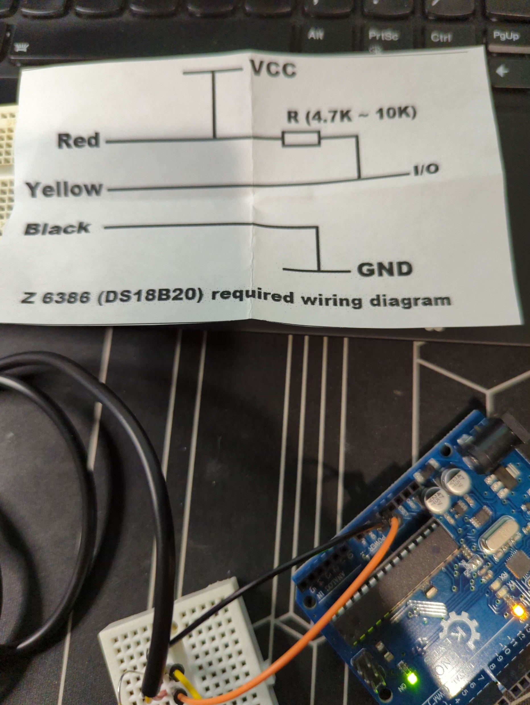
IoT Temperature Device
Wiring diagram

Slide 14
IOT Device 1.
Remember to use the right resistor.

Slide 15
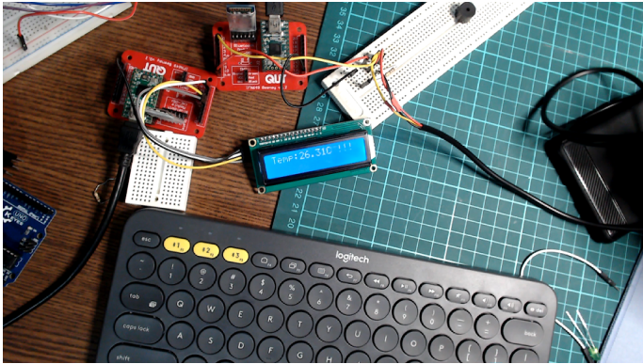
Temp + LCD working
Can only use first row due to limited power
If Temp is Below 4 it will display OK
If it is equal to 4 and less than 8 displays !
If it is more than 9 it will display !!!

Slide 16
Mode Testing
Completed

Slide 17
Rotatory Encoder

